Slide 1
GIS Development Project City of Woodcreek, TX
Final Report
GEO 4427 Advanced GIS II

Slide 2
Overview
Final report on the development of a GIS for The City of Woodcreek, TX…
Background
Purpose
Scope
Data (Addition of Naming Conventions)
Completed Work and Methodology
Website
Guide to Google
Conlcusions

Slide 3
Background
Incorporated in 1984
Population of approximately 1300
Encompasses 686 Acres

Slide 4
Problem
The City of Woodcreek, Texas has no formal mapping system in digital format.
Only hard copies of map of data, past and present, available for planning.
Among the problems associated with physical hardcopies of maps is they cannot be displayed to a mass audience.
Also, the hardcopies cannot be updated quickly with new data such as updates to:
utilities
boundaries
roads
signage.

Slide 5
Purpose
The purpose of this project is to build a formal mapping system for the City of Woodcreek, by developing a GIS database.
This mapping system will display:
zoning regulations
administrative boundaries
topographic information
infrastructure status.

Slide 6
Scope

Slide 7
Secondary Data
Data Acquisition and Relevance
Primary Data: GPS Sign Points and Digital Photographs
Source | Datasets Acquired
Capital Area Council of Governments (CAPCOG) | Street Centerlines
 | Aerial Imagery
 | Property Parcels
Texas Natural Resource Information System (TNRIS) | Floodplain Data
Hays County | County Boundary
 | City Limit Boundary
City of Woodcreek | Traffic Sign Locations
 | Fire Hydrant Locations
 | Road Conditions Zoning Regulations

Slide 8
Problems with Acquiring Data
GPS Units and Accuracy
Weather
Reflection
Map Originals
Points not to scale
No true geographic reference (i.e. Coordinate System)
1 business relocated after first field collection

Slide 9
Completed Work and Methodology

Slide 10
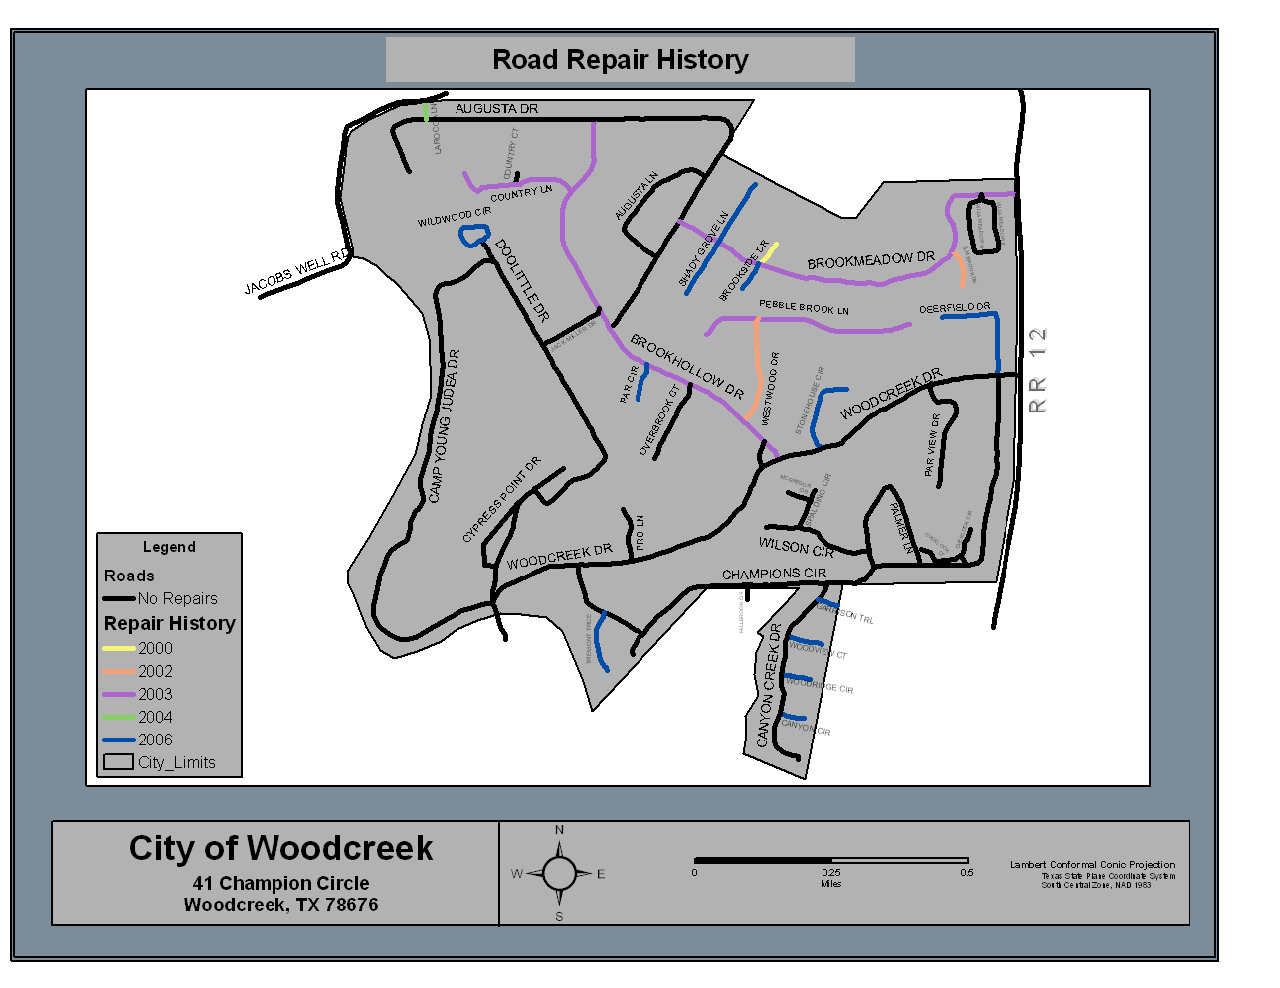
Road Repair History Map

Slide 11
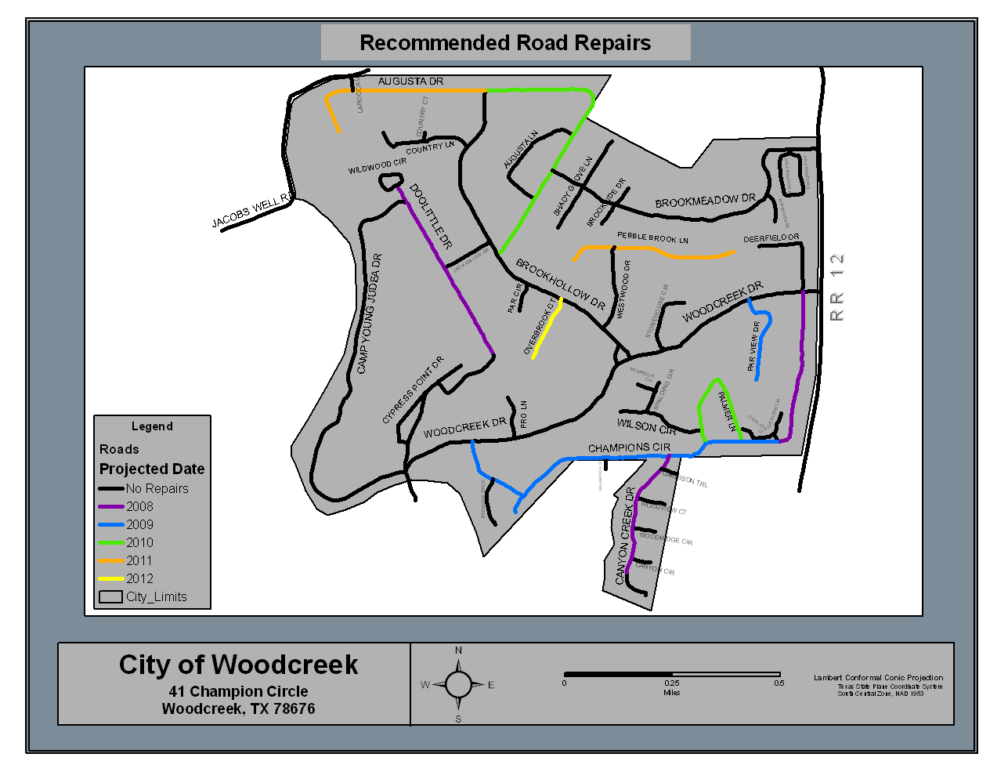
Recommended Road Repair Map

Slide 12
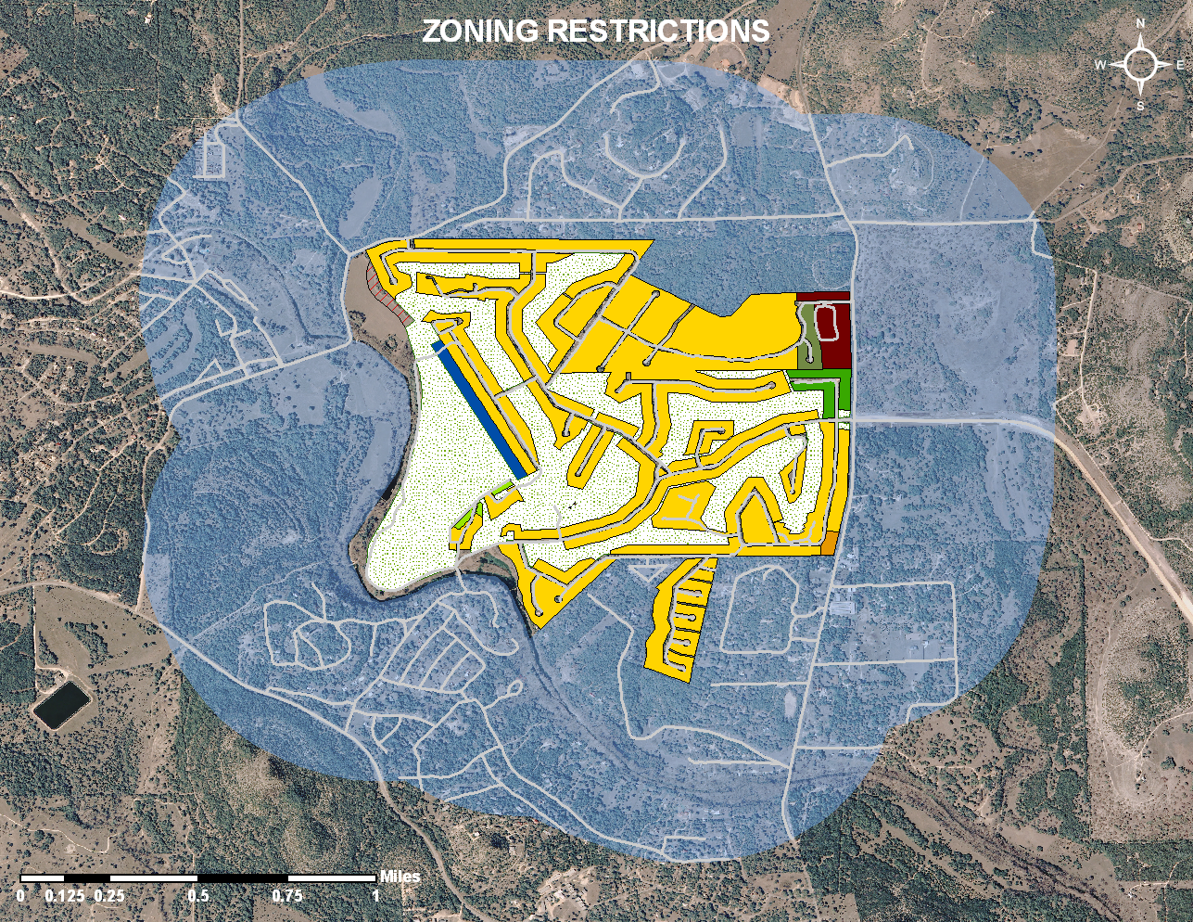
Generalized Zoning Map

Slide 13
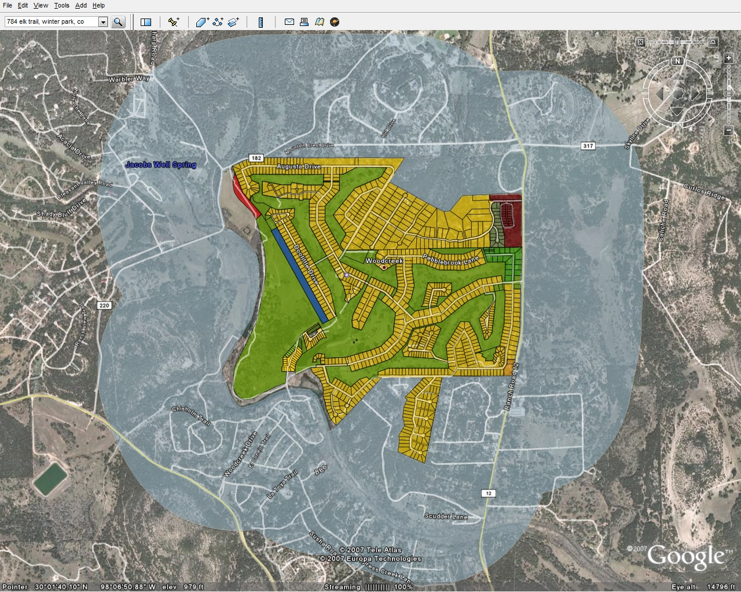
Zoning Map with Parcels

Slide 14
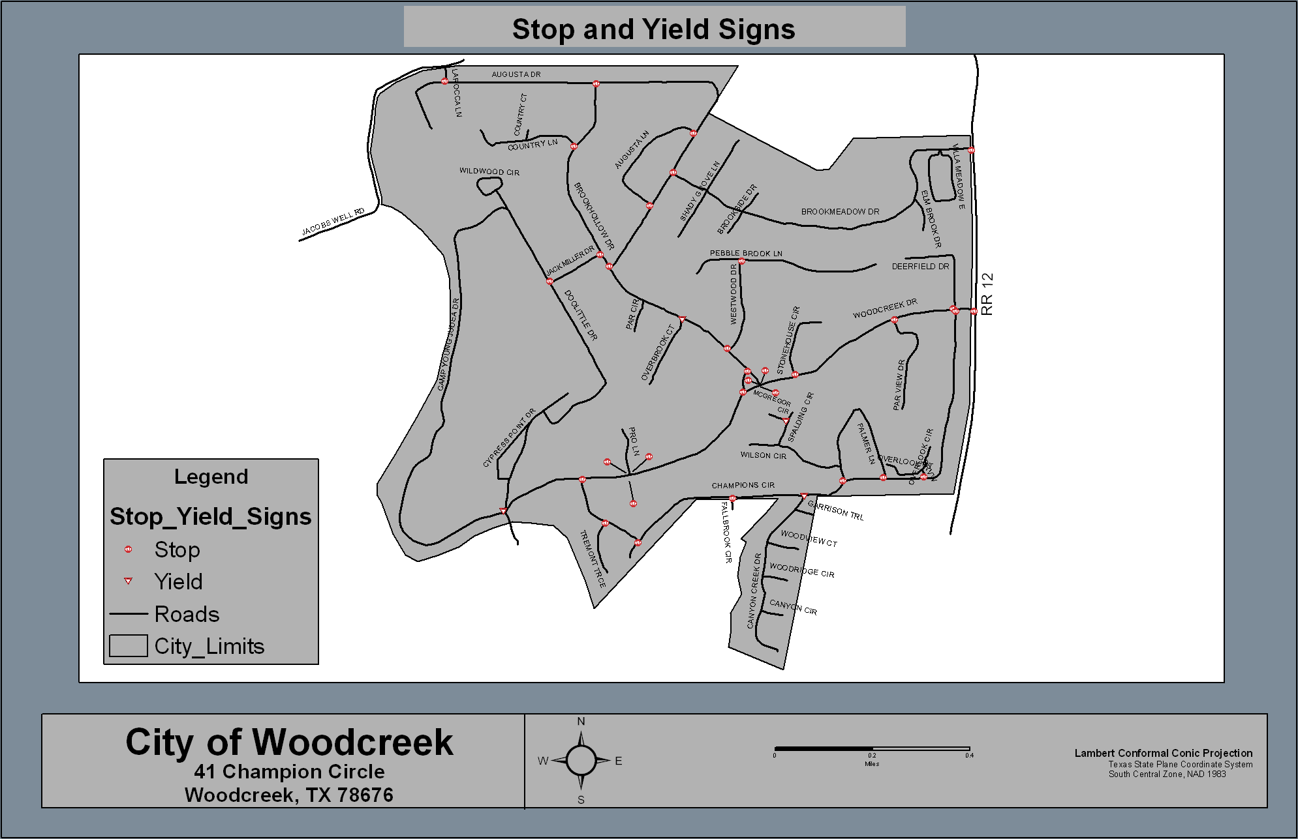
Stop and Yield Sign Location Map

Slide 15
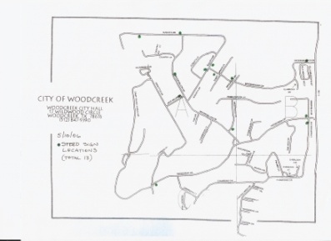
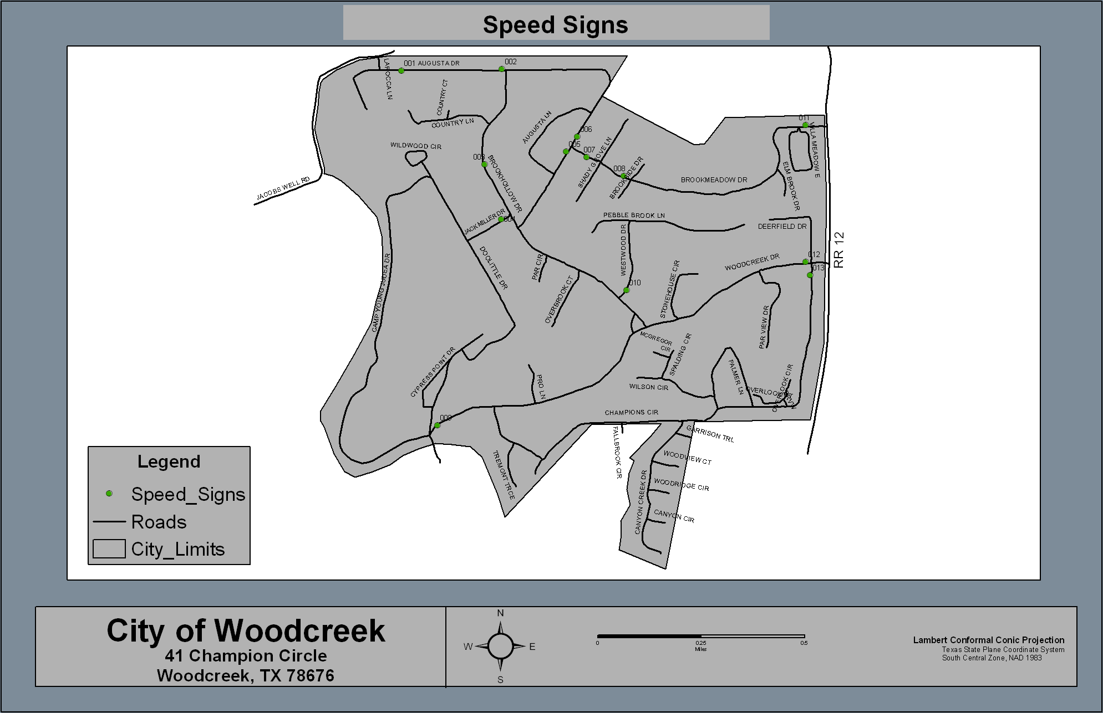
Speed Sign Location Map

Slide 16
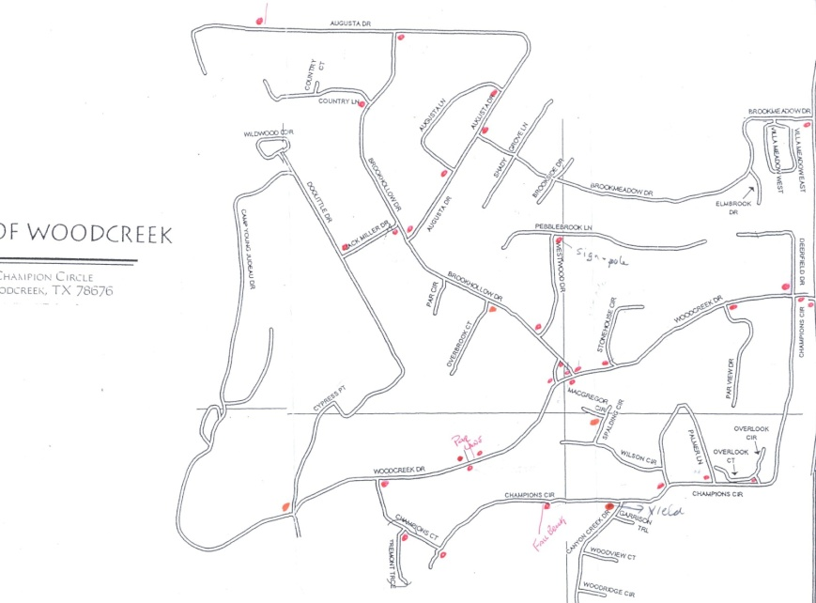
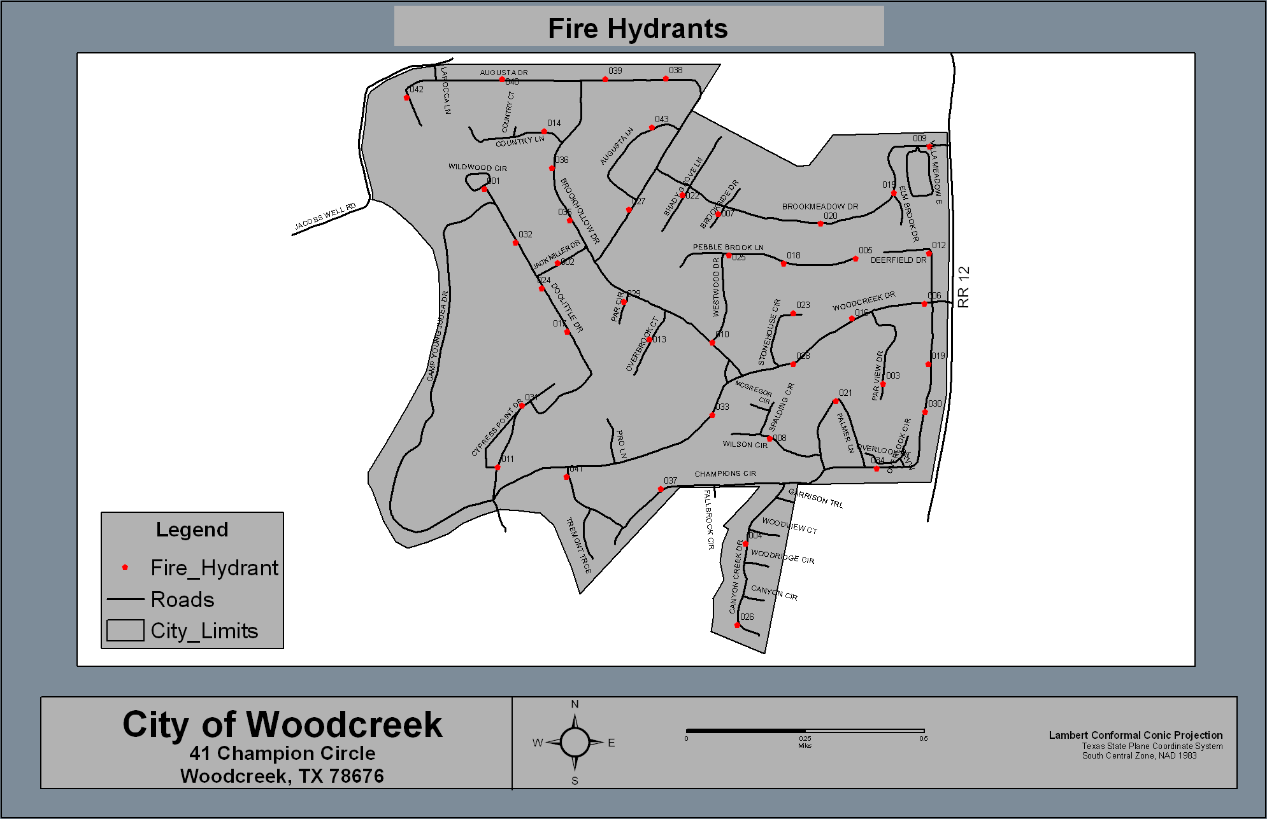
Fire Hydrant Location Map

Slide 17
Updated Floodplain Map

Slide 18
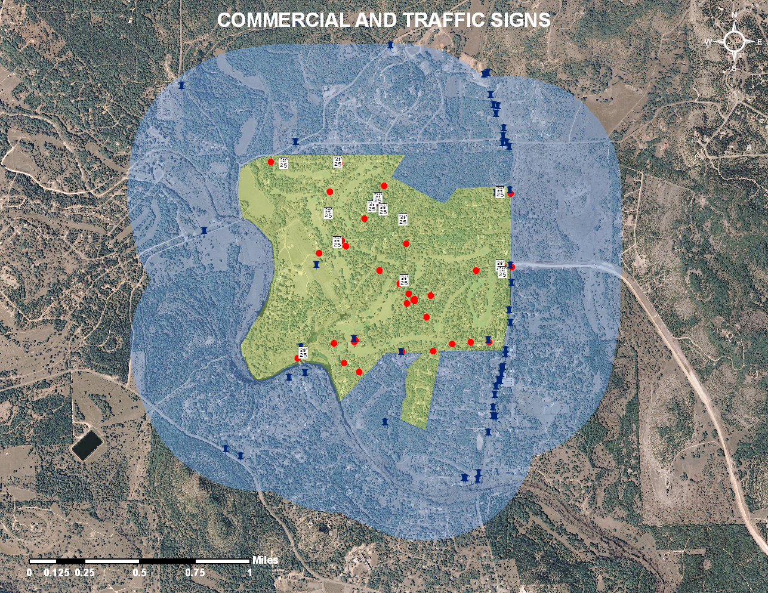
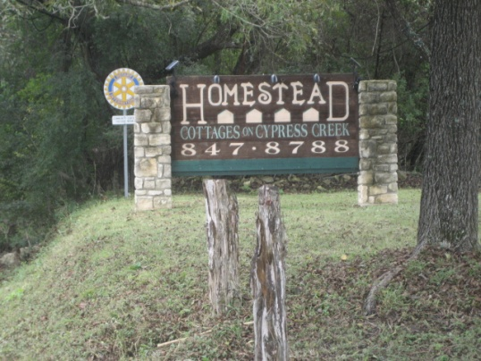
Business Sign Map

Slide 19
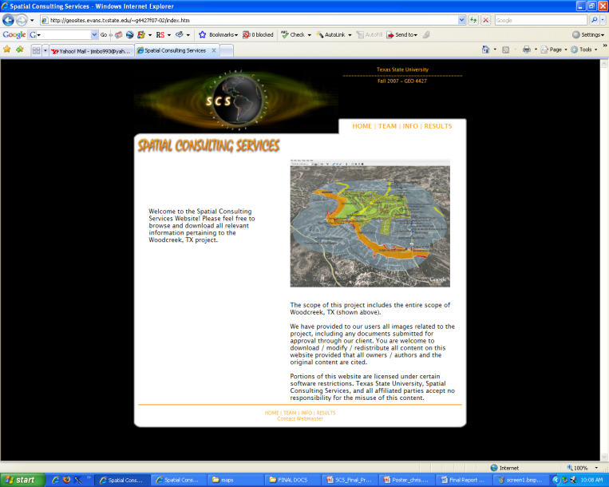
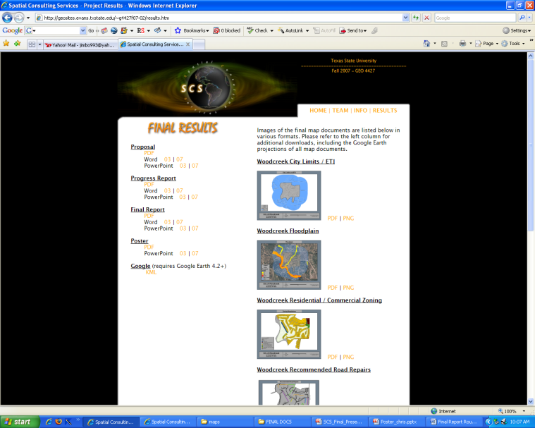
Website
Goal and Purpose
Navigation
Documents
Maps
Poster
Contacts
Google

Slide 20
Overview of Completed Work
Recommended Road Repair Map
Road Repair History Map
Zoning Maps
Stop and Yield Sign Map
Speed Sign Map
Fire-Hydrant Location Map
Updated Floodplain Map
Business Sign Map
Google Interactive Map Display

Slide 21
Implications
Now Possess Formal mapping System
Digital
Hard Copy
Can now display to mass Audience
Can now easily update

Slide 22
Conclusions

